Slide 1
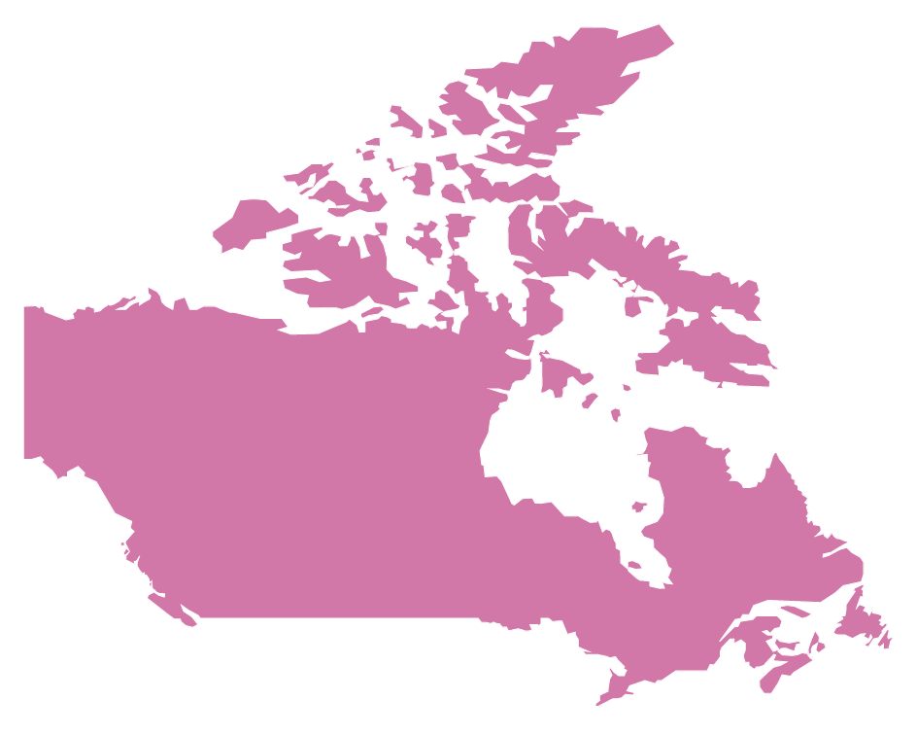
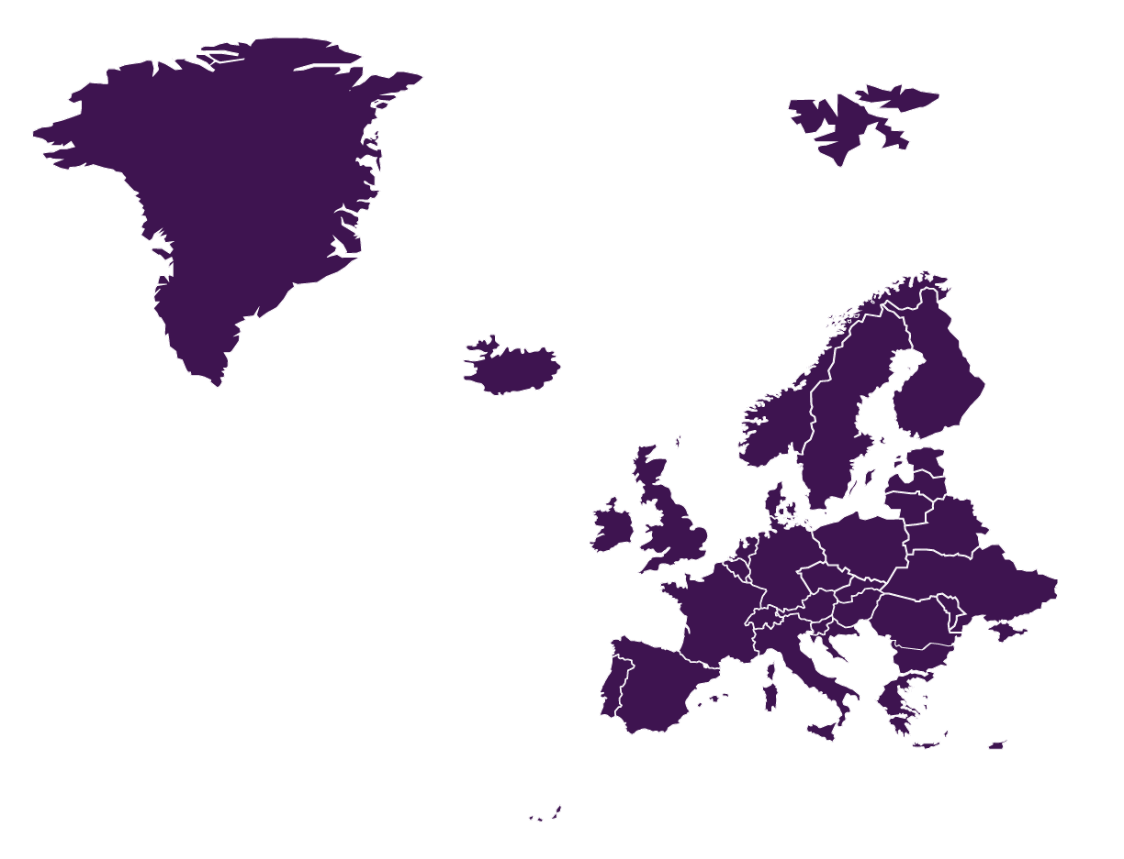
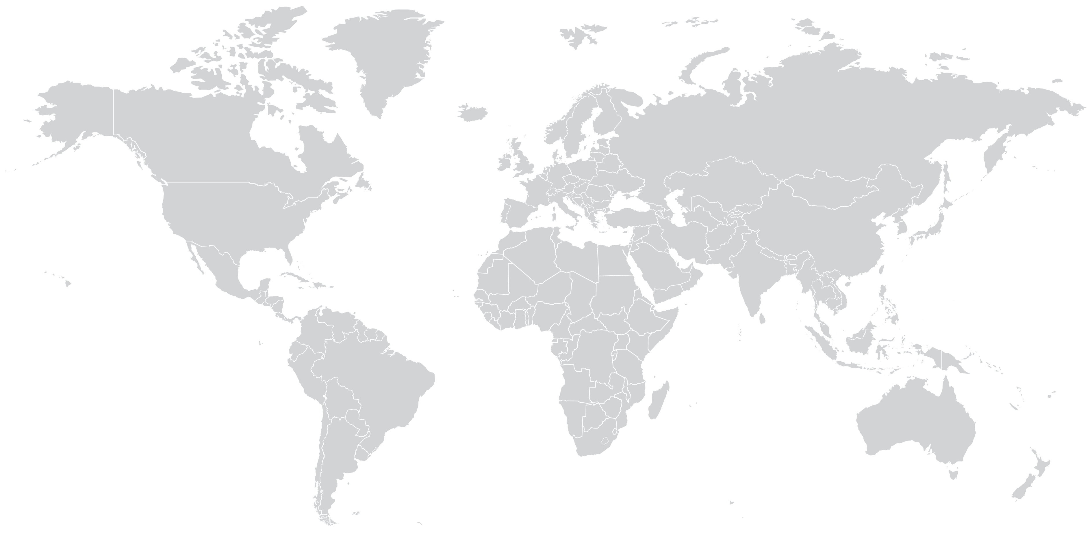
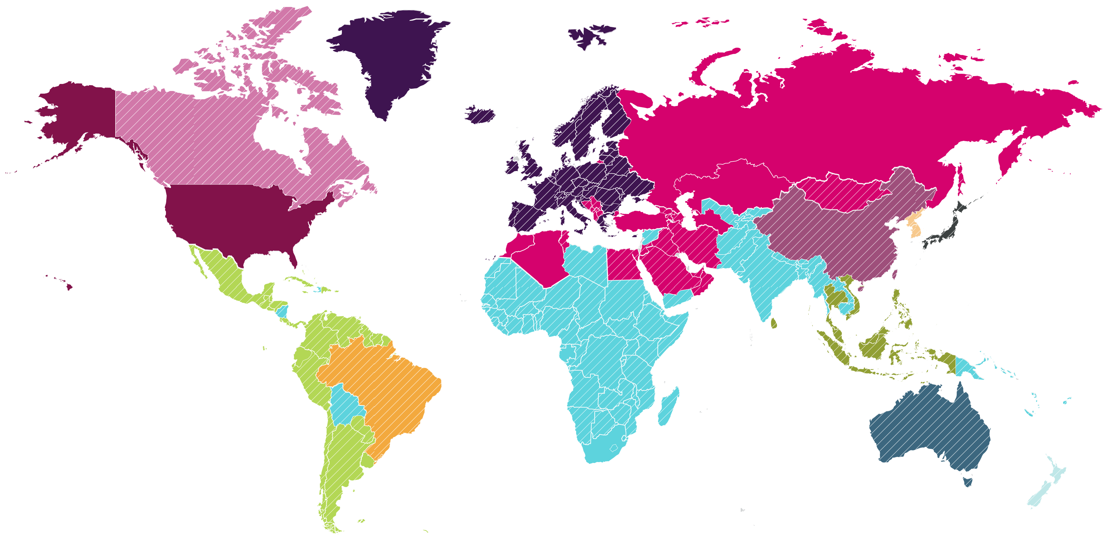
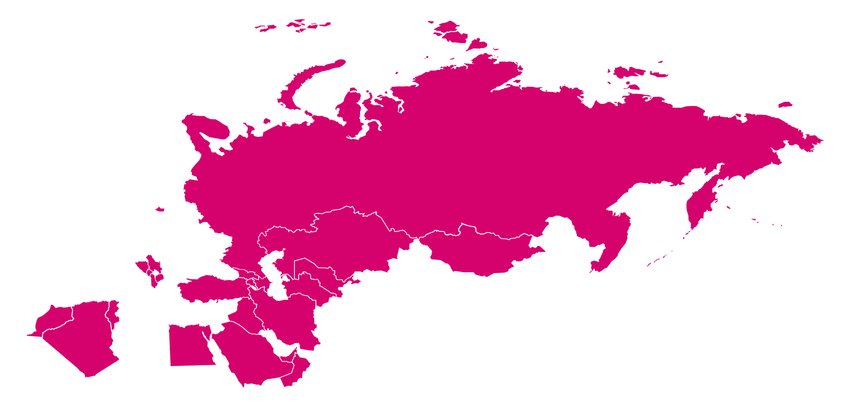
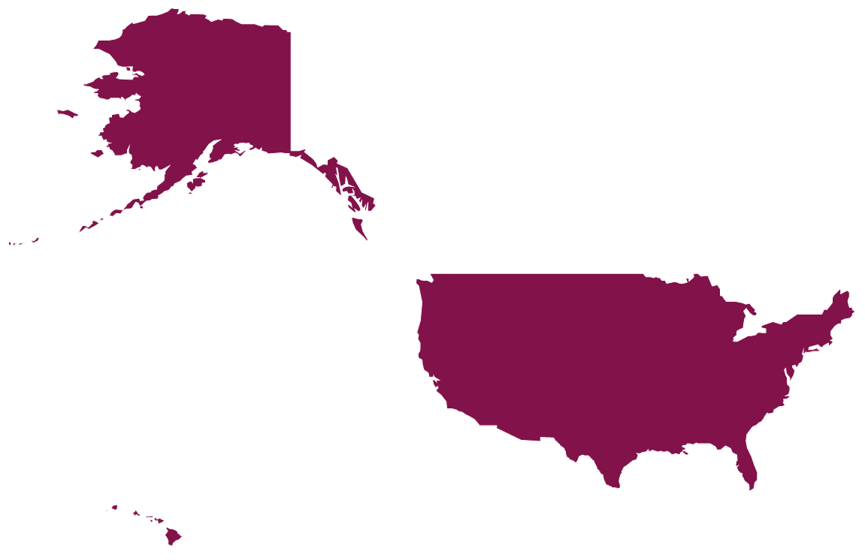
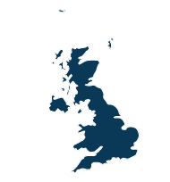
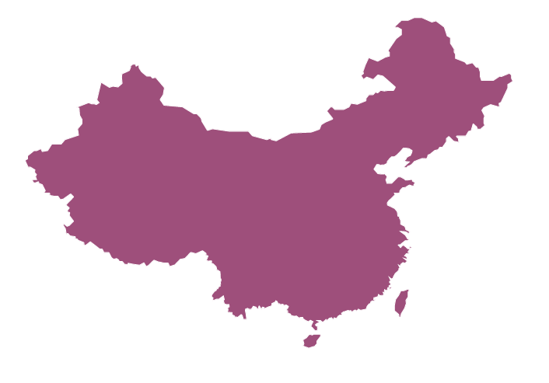
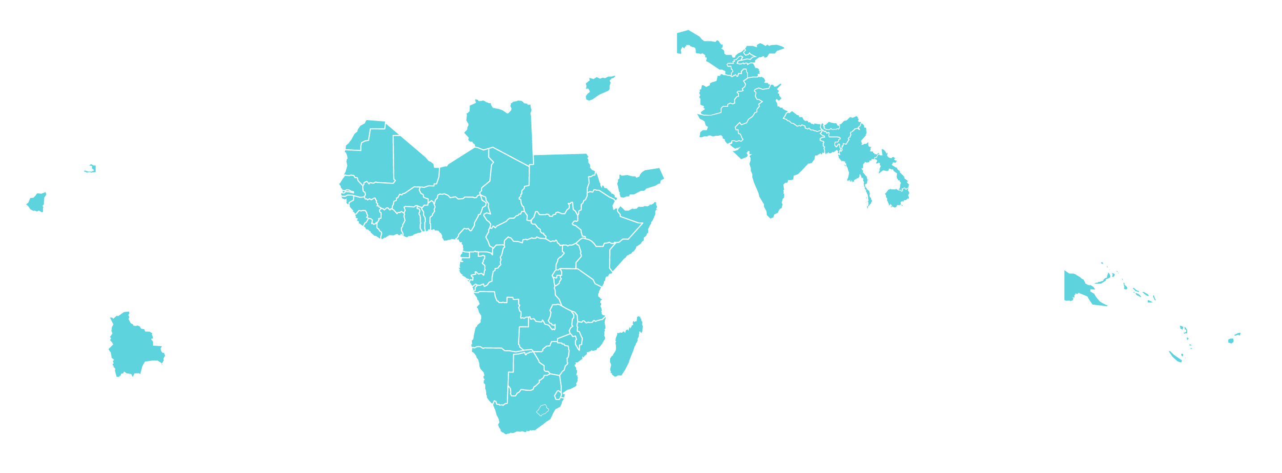
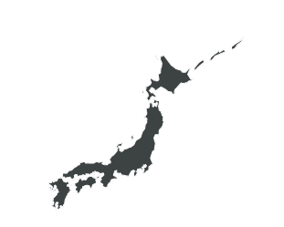

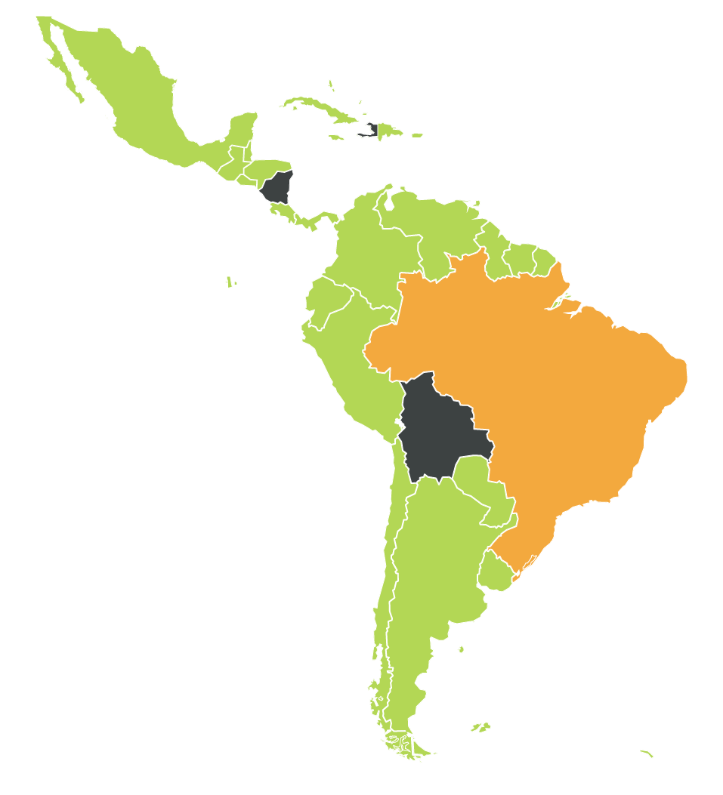

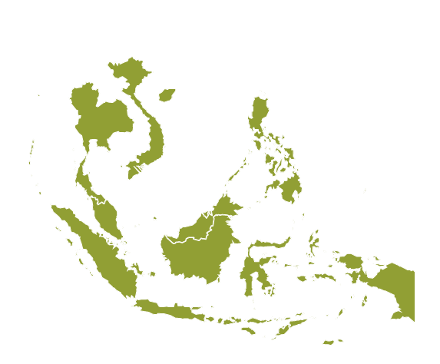

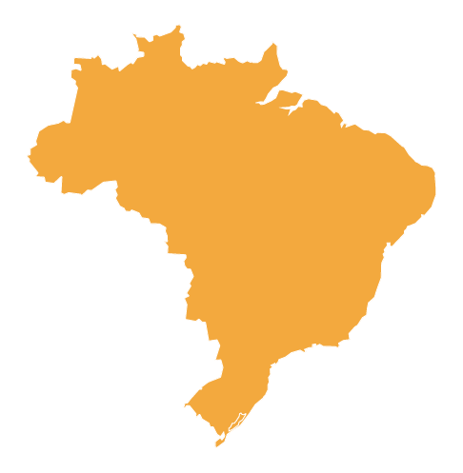
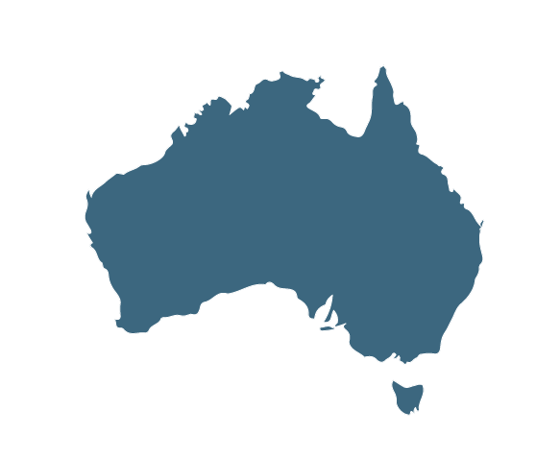
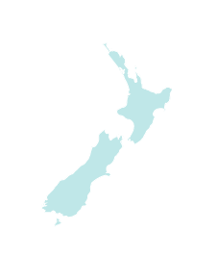



Established supply capacity to enable broad, equitable access towards 3bn doses worldwide
Establishing parallel agreements to ensure global access:
April
UK*
May
USA*
EU Commission
June
SII
UK
CEPI-GAVI COVAX
R-Pharm
R-Pharm**
Canada
July
South Korea
SK Bioscience
August
Europe*
US
Japan
Brazil
BioKangTai
200m doses
LATAM (Ex Brazil)*
Israel
Japan*
China
September
Australia*
Carlos Slim
(Liomont/Mabxience)
SII
SCG
October
SE Asia*
November
Canada*
Fiocruz
Israel*
CSL
CEPI-Gavi / COVAX - 300m doses
Continued engagement with intl. orgs and govts to drive equitable access
= Countries that have signed commitment
agreements to the COVAX Facility as of October 29

